Slide 1
Childhood Mortality
Community Health Strand

Slide 2
Introduction
Mortality in children under the age of five years
10- 11 million child deaths occur in the world every year

Slide 3
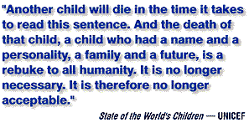
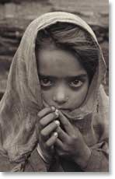

Slide 4
More than 70 per cent of them are attributable to six causes:
  Diarrhoea,
  Malaria
  Neonatal infections
  Pneumonia
  Preterm delivery
  Birth asphyxia

Slide 5
Childhood deaths mainly occur in the developing countries
South-central Asia has the highest number of neonatal deaths
Sub-Saharan Africa has the highest overall rates
Two-thirds of deaths occur in just 10 countries.

Slide 6
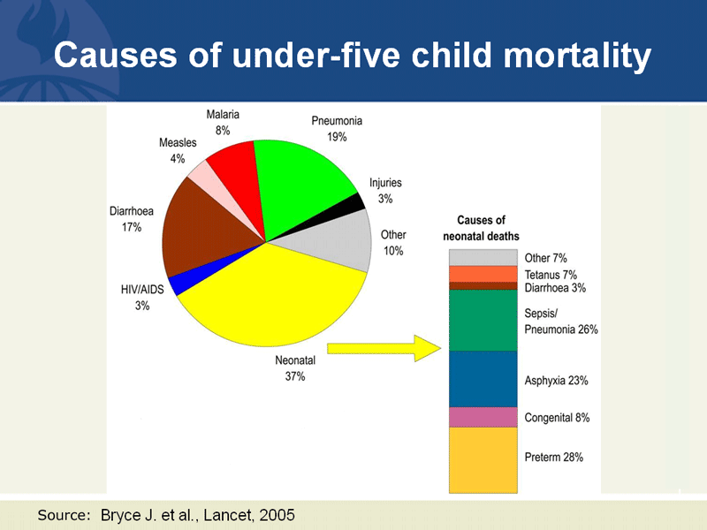

Slide 7
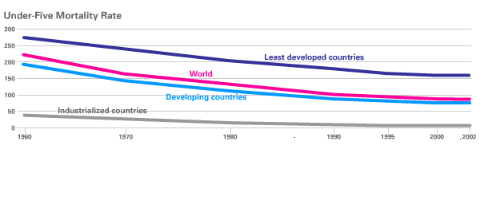
Under 5 Mortality 1960-2002

Slide 8
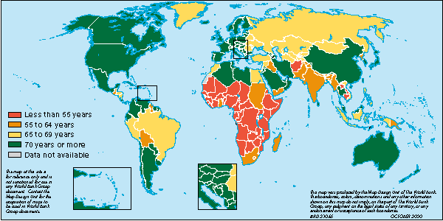
Life Expectancy at Birth

Slide 9
Majority are preventable
  illnesses like measles, malaria or tetanus
  Indirect effects of marginalization
  conflict
  HIV/AIDS
Malnutrition and the lack of safe water and sanitation contribute to half of all these deaths.

Slide 10
An Ethiopian child is 30 times more likely to die by his or her fifth birthday than a child in Western Europe.

Slide 11
Over half of these deaths can be saved by low-tech, evidence-based, cost-effective measures such as:
  Immunisation
  Use of antibiotics
  Micronutrient supplementation
  Insecticide-treated bed nets I
  Improved family care and breastfeeding practices.

Slide 12
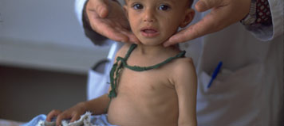

Slide 13
Millennium Development Goals-2000
Goal: Reduce child mortality
Targets by 2015:
To reduce child mortality by two-thirds, from 93 children of every 1,000 dying before age five in 1990 to 31 of every 1,000 in 2015.

Slide 14
Stake-holders
Governments
WHO
UNICEF
Other UN Organisations/ International foundations
Private sector
Civil society

Slide 15
Role of UNICEF
The United Nations Children’s Fund
Theme: Improved child survival
Aims to increase the adoption of proven, high-impact, cost-effective health and nutrition interventions to reduce the number of neonatal and young child deaths from preventable and easily treatable causes

Slide 16
UNICEF - Strategies
  Immunisation
  Micro-nutrient supplementation
  Prevention of malaria by the use of bed nets
  Promotion of breast feeding
  Improving maternal care
  Improving family care practices
  Improving access to safe water and sanitation
  Improving health care systems
  Influencing Policy
  Development of partnerships
  Responding to emergencies

Slide 17
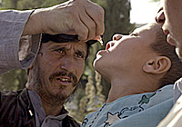

Slide 18
Immunisation
UNICEF is the world’s largest purchaser of vaccines, procuring more than 40 per cent of all vaccines used in the developing world
Negotiates favourable prices and estimates vaccines requirements to ensure sustainable supplies
Targets to increase immunization coverage to at least 90 per cent at the national level and 80 per cent in all districts, with particular focus on reaching population groups with low coverage levels, and the final eradication of polio.

Slide 19
Global immunization rates have risen from less than 20% in the 1970s to about 74% in 2002

Slide 20
Micro-nutrient Supplementation
Micronutrient supplements are delivered to communities to combat malnutrition in children
Supplements of vitamin A taken every four to six months can reduce child mortality from all causes by as much as 23 per cent, measles deaths by 50 per cent and deaths from diarrhoea by 33 per cent.

Slide 21
Prevention of malaria
Increasing the rate of children sleeping under mosquito nets to at least 60 per cent in malaria-endemic areas
*Malaria is responsible for 10 per cent of all under-five deaths in developing countries.

Slide 22
Promotion of breast feeding
Poor neonatal conditions are the most prominent cause of young deaths (WHO)
Four million babies per year die in the first week of life. In response, UNICEF advocates for and promotes programmes to increase rates of exclusive breastfeeding

Slide 23
Maternal care
Provision of technical and financial support to comprehensive community health programs for pregnant females
Include providing micronutrient supplements, vaccines, anti-malarial drugs and insecticide-treated bed nets.

Slide 24
Family Care Practices
About 80 per cent of health care in developing countries occurs in the home
Majority of children die at home, without being seen by a health worker
  * As many as 40 per cent of child deaths could be prevented with improved family and community care

Slide 25
Access to safe water and sanitation
Development of safe water systems
Improve water and hygiene resources

Slide 26
Responding to emergencies
Following an emergency/ outbreak establishing monitoring systems, organising partnerships and providing vaccinations and vitamin A supplementation.

Slide 27
Improving health care systems
  Support technical capacities in programmes
Influencing Policy
  Helps to strengthen policies and budgets
Development of Partnerships
  With governments, health providers and communities
  Pools competencies and resources

Slide 28
Conclusion
There has been a fifty per cent reduction in under-five mortality between 1960 and 2002
Meeting the Millennium Goal on reducing child mortality is difficult
  In 2002, 7 of every 1,000 children in industrialized countries died before they were five
  In South Asia, 97 of 1,000 children died before they were five.
  In sub-Saharan Africa, that number is 174 of every 1,000 children.

Slide 29
Ninety countries (53 – developing) should be able to meet the 2015 Goal of reducing child mortality by two-thirds, if they maintain their current annual reduction rate.
But 91 developing countries are far behind
  Countries from sub-Saharan Africa
  Iraq
  Former members of the Soviet Union.

Slide 30
Latest press release by UNICEF (21.09.2007) announced that global childhood mortality has reduced to below 10 million for the first time ever
Recorded 9.7 million in the last year
  4.8 m Sub-saharan Africa
  3.1 m South Asia
  6/ 1000 live births in developed countries

Slide 31
References
http://rehydrate.org/facts/child_deaths.htm
http://www.unicef.org/

